Slide 1
Spacecraft Estimation and Control

Slide 2
Pt 1: Attitude Estimation in Orbit
Frames of Reference
Orbit Simulation
Sensors : Locations, Rate, and Noise Characteristics
Kalman Filtering Attitude Estimates vs Truth
Star tracker + Gyro
Star tracker + Gyro + Magnetometer
Star tracker + Gyro + Magnetometer
Kalman Filtering Position + Attitude Estimates
Star tracker + Gyro + Accelerometer + Magnetometer + GPS
Arbitrary Selection: ISS Zarya
1 25544U 98067A 23294.71555876 .00018021 00000+0 32845-3 0 9990
2 25544 51.6434 61.7990 0000769 93.2438 47.7876 15.49523271421418
https://celestrak.org/NORAD/elements/gp.php?GROUP=stations&FORMAT=tle

Slide 3
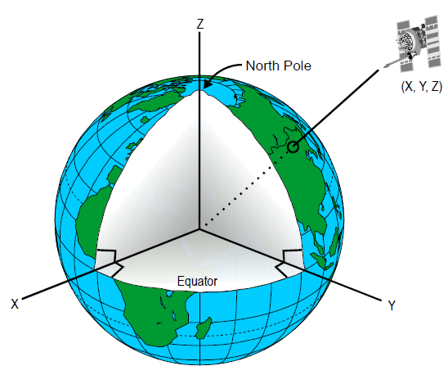
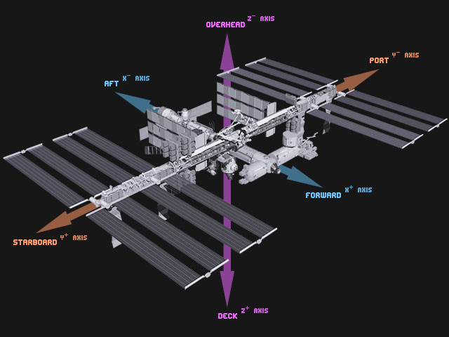
Frames of Reference
Earth Centered Inertial (ECI)
True Equator, Mean Equinox (TEME)
Zenith
Forward, Starboard, Nadir (FSN)
Nadir

Slide 4
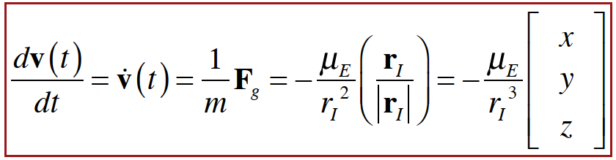
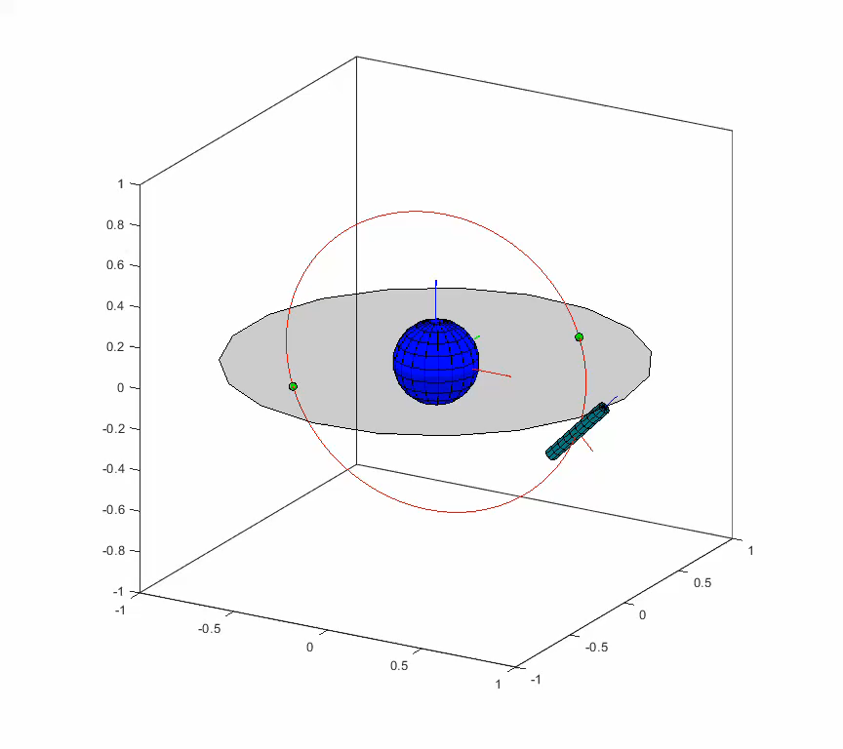
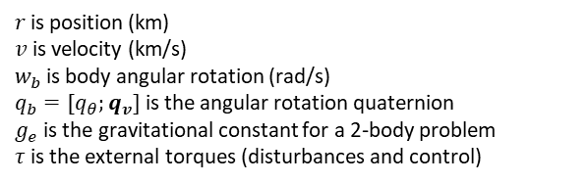
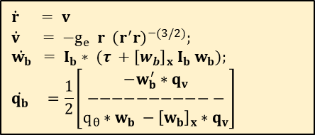
Orbit Simulation
Step 1: Extract initial conditions (position and velocity) for orbit from TLE using SGP4
Step 2: Generate an idealized (cylindrical) angular inertia tensor using details for a medium satellite:
Mass = 200 kg (from Outpost specs)
Length = 1 meter
Radius = 0.2 meters
Step 3: Using MATLAB ode45 (Runge Kutta integration) where the state vector is…
Visualization is key!
$$\dot{r} = v$$
$$\dot{v} = −g_{e} r {\left(r^{′}r\right)}^{−(3/2)};$$
$$\dot{w_{b}} = I_{b}∗ (τ +{\left[w_{b}\right]}_{x}{ I}_{b} w_{b});$$
$$\dot{q_{b}} =\frac{1}{2}\left[\begin{aligned}−w_{b}^{′}∗q_{v} \\ −−−−−−−−−−− \\ q_{θ}∗w_{b} −{\left[w_{b}\right]}_{x}∗q_{v}\end{aligned}\right]$$
$r$ is position (km)
$v$ is velocity (km/s)
$w_{b}$is body angular rotation (rad/s)
$q_{b}=[q_{θ};q_{v}]$is the angular rotation quaternion
$g_{e}$ is the gravitational constant for a 2-body problem
$τ$is the external torques (disturbances and control)

Slide 5
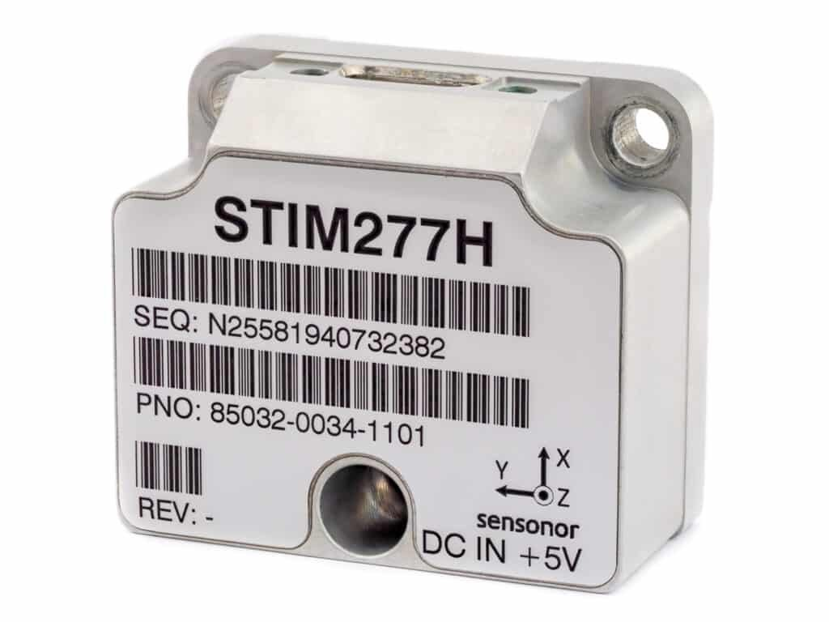
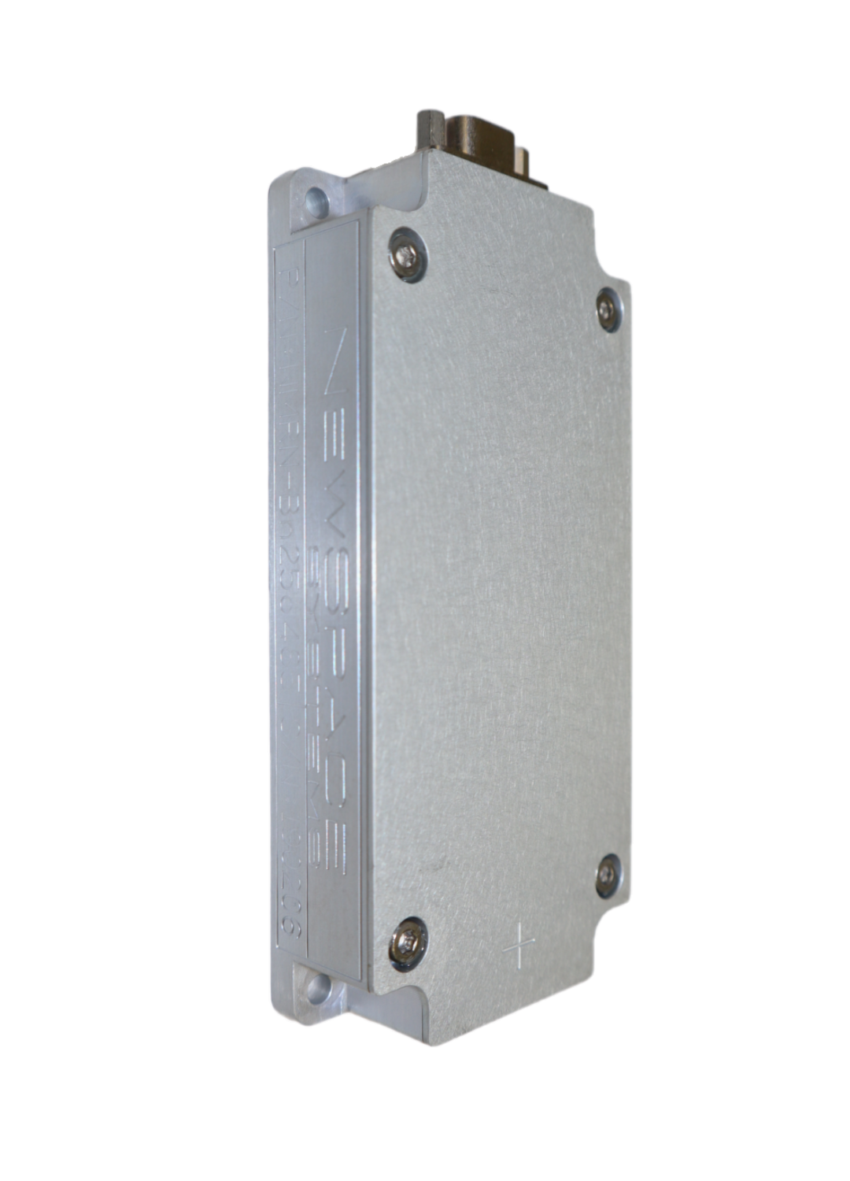
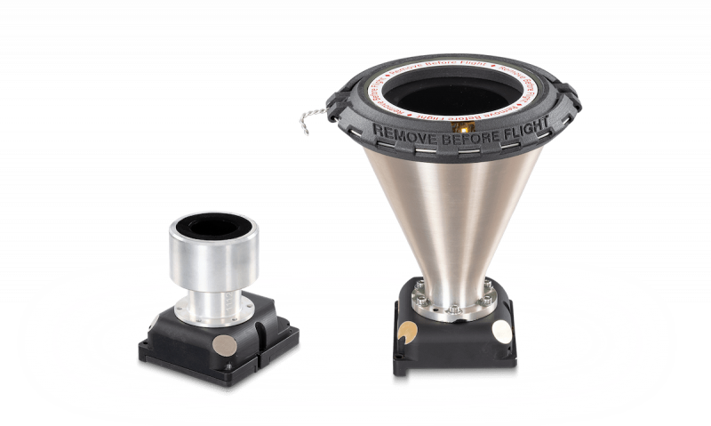
Sensors: Locations, Rate, and Noise Characteristics
In the simulation all of the sensors were aligned with no offset between the FSN coordinate system – based on the inertia tensor.
3-axis Gyroscope (rad/s)
40 Hz
Gaussian noise covariance = 0.001
Gyro bias Markov noise
mean offset = 5e-3
std. deviation = 1e-5
autocorrelation coefficient = 1
Magnetometer
40 Hz
Heading noise covariance (deg) = 0.1
Star Tracker
1 Hz
Gaussian noise covariance (deg) = 1e-5
Accelerometer (todo)
Next steps include fusing position and velocity estimates from GPS with accelerometers (and attitude) for orbit burns
Bias Stability 0.3°/h,
ARW 0.15°/√h
https://safran-navigation-timing.com/product/stim277h-mems-gyroscope/?model_interest__c=STIM277H&product_interest___single_select=IMUs+and+Gyroscopes
https://www.rocketlabusa.com/space-systems/satellite-components/star-trackers/
https://www.newspacesystems.com/products/magnetometers/

Slide 6

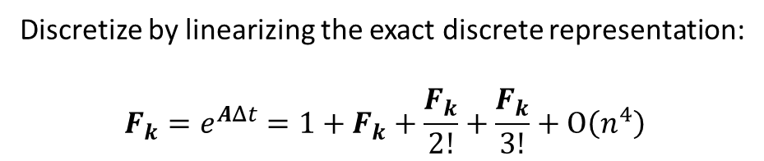
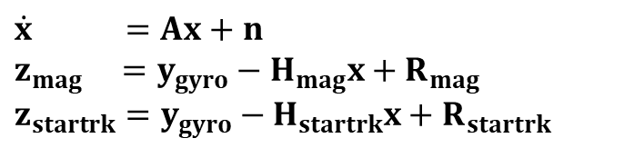
Kalman Filtering Estimates vs Truth
Perform the Kalman filter in the local gyro body frame
+ This allows us to have a constant state transition matrix
+ The process covariance matrix is also constant
Both of these operations are performed every gyro integration, so much savings! $$$
$$x=\left[6x1\right]=\left[\begin{aligned}euler error \\ gyro bias\end{aligned}\right]$$
$$\dot{x} =Ax+n$$
$$z_{mag} =y_{gyro}−H_{mag}x+R_{mag}$$
$$z_{startrk}=y_{gyro}−H_{startrk}x+R_{startrk}$$
Discretize by linearizing the exact discrete representation:
$$F_{k}=e^{AΔt}=1+F_{k}+\frac{F_{k}}{2!}+\frac{F_{k}}{3!}+Ο\left(n^{4}\right)$$
Use the covariance matrices as tuning nobs based on how accurate / noisy we consider them to be.

Slide 7
Pt 2: Spacecraft Control
Control Objective:
Align the spacecraft to the FSN frame using idealized point torques created with reaction wheel limitations in mind.
Checkpoints:
Instantaneous point torques
Undisturbed
Realistic orbital disturbances
Use models for actuator physics
Use Kalman Filter outputs as inputs for controller
Use a measured inertia tensor matrix
Place actuators in realistic locations
Using optimal control (Hamiltonian minimization), plan a trajectory that minimizes net torque given max and saturation constraints
Perform orbit raising and declining maneuvers

Slide 8
Pt 2: Spacecraft Control
Control Objective:
Align the spacecraft to the FSN frame using idealized point torques created with reaction wheel limitations in mind.
Checkpoints:
Instantaneous point torques
Undisturbed
Realistic orbital disturbances
Use models for actuator physics
Use Kalman Filter outputs as inputs for controller
Use a measured inertia tensor matrix
Place actuators in realistic locations
Using optimal control (Hamiltonian minimization), plan a trajectory that minimizes net torque given max and saturation constraints
Perform orbit raising and declining maneuvers

Slide 9
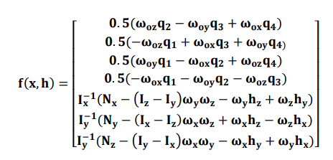
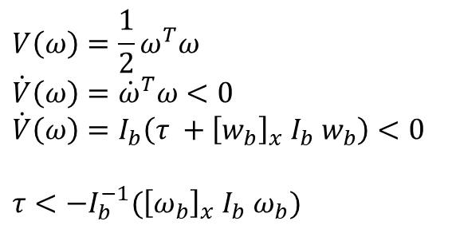
Attitude Controller – Problem Description
Attitude dynamics are nonlinear with body velocity, and for realistic non diagonal inertia matrices have multiple nonlinearities.
Idea: separate the controller design into 3 scenarios
Detumbling / recovery- Global exponential stability (Lyapanov controller design to drive rotation to zero)
Transition to desired attitude – slow, possibly local waypoints for local trajectory
Error minimization near desired attitude / waypoint – linearized control law with high performance.
Globally exponentially stable lyapanov-based controller
$$V\left(ω\right)=\frac{1}{2}ω^{T}ω$$
$$\dot{V}\left(ω\right)={\dot{ω}}^{T}ω<0$$
$$\dot{V}\left(ω\right)=I_{b}\left(τ +{\left[w_{b}\right]}_{x}{ I}_{b} w_{b}\right)<0$$
$τ<−I_{b}^{−1}({\left[ω_{b}\right]}_{x}{ I}_{b} ω_{b})$

Slide 10
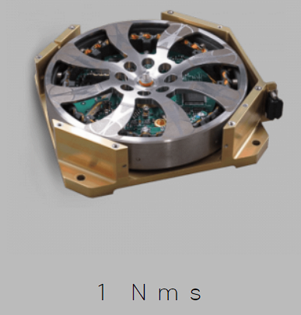
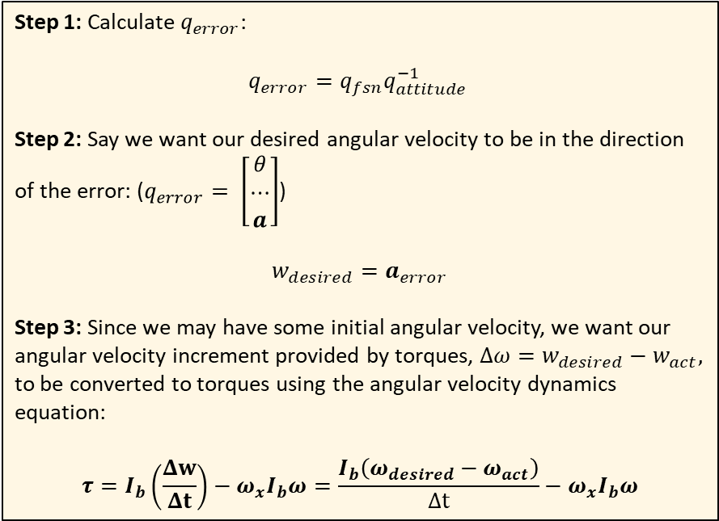
Attitude Controller – Coarse Control
Basic control law: (coarse correction)
Step 1: Calculate $q_{error}$:
$$q_{error}=q_{fsn}q_{attitude }^{−1}$$
Step 2: Say we want our desired angular velocity to be in the direction of the error: ($q_{error}= \left[\begin{aligned}θ \\ ⋯ \\ a\end{aligned}\right]$)
$$w_{desired}=a_{error}$$
Step 3: Since we may have some initial angular velocity, we want our angular velocity increment provided by torques, $Δω=w_{desired}−w_{act},$ to be converted to torques using the angular velocity dynamics equation:
$$τ=I_{b}\left(\frac{Δw}{Δt}\right)−ω_{x}I_{b}ω=\frac{I_{b}\left(ω_{desired}−ω_{act}\right)}{Δt}−ω_{x}I_{b}ω$$
100 mN m

Slide 11
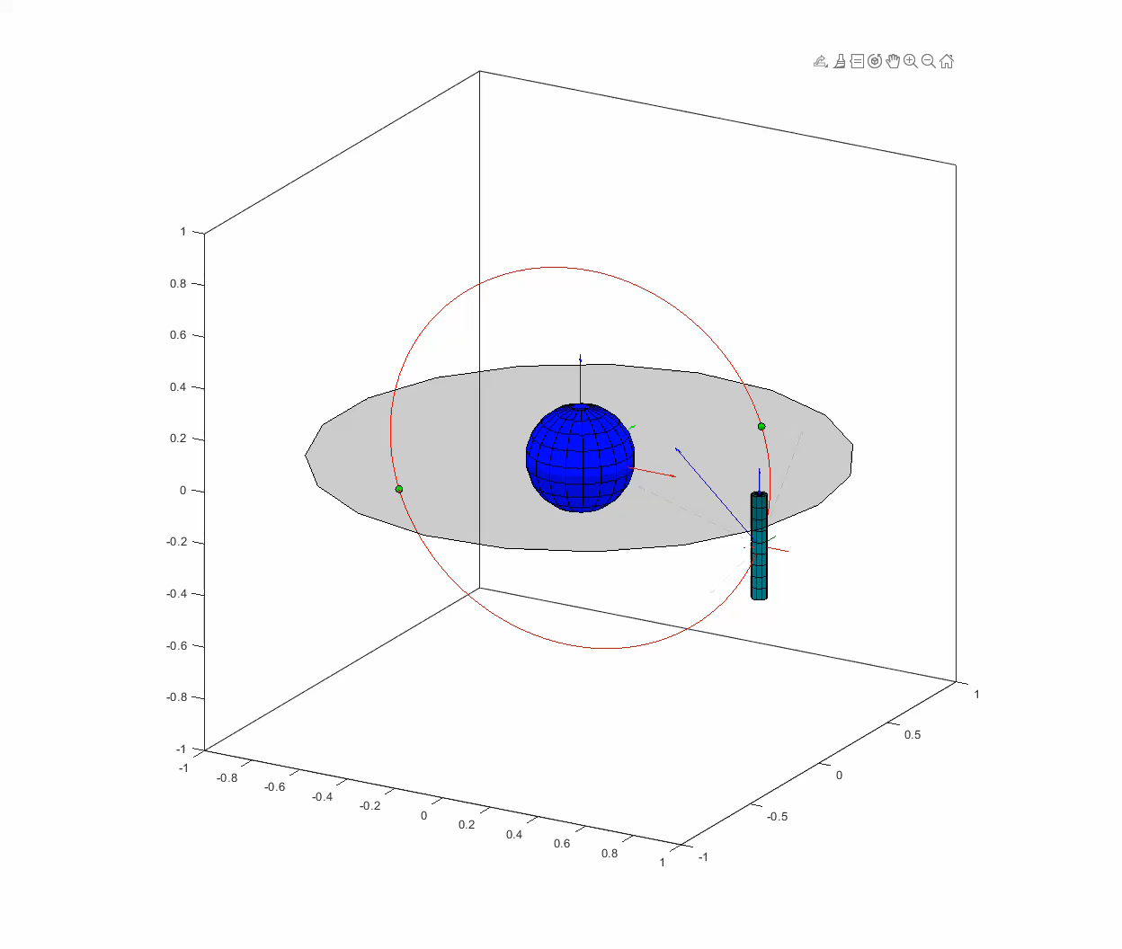
Attitude Controller – Coarse Control
Max torque = 0.05 Nm, Max w_des = 0.2 rad/s
10x sped up for manuever
100x sped up for orbit

Slide 12
Attitude Controller – Coarse Control
Max torque = 0.05 Nm, Max w_des = 0.2 rad/s
10x sped up for manuever
100x sped up for orbit
RW over torque and saturated
- Steady-state error (no surprise)
- Almost all in the body pitch direction

Slide 13
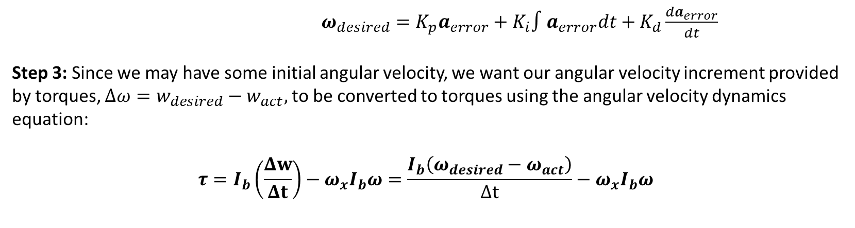
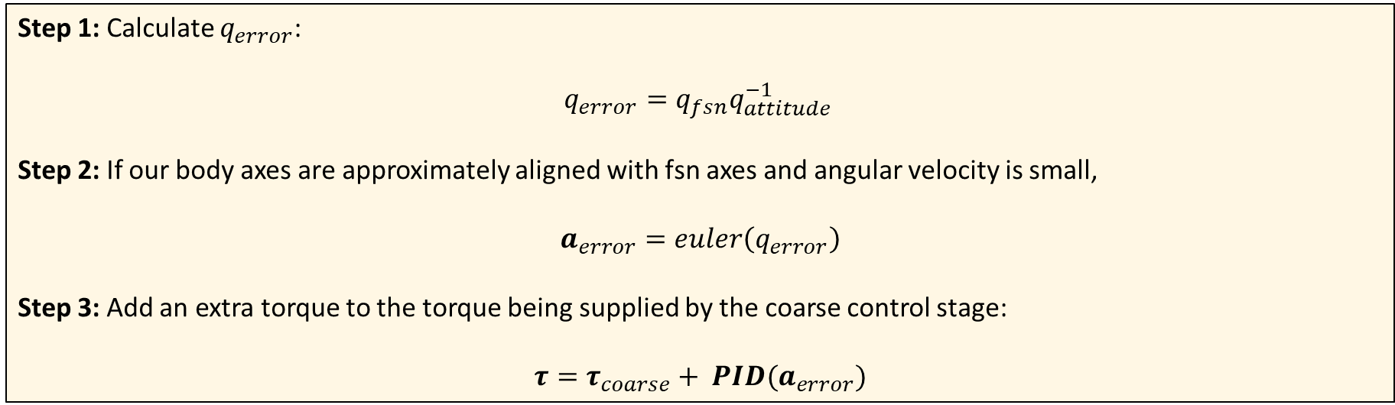
Attitude Controller – Fine Control
Basic control law: (fine correction – linear euler angles with integral compensation)
Step 1: Calculate $q_{error}$:
$$q_{error}=q_{fsn}q_{attitude }^{−1}$$
Step 2: If our body axes are approximately aligned with fsn axes and angular velocity is small,
$$a_{error}=euler\left(q_{error}\right)$$
Step 3: Add an extra torque to the torque being supplied by the coarse control stage:
$$τ=τ_{coarse}+ PID(a_{error})$$
$ω_{desired}=K_{p}a_{error}+K_{i}∫a_{error}dt+K_{d}\frac{da_{error}}{dt}$
Step 3: Since we may have some initial angular velocity, we want our angular velocity increment provided by torques, $Δω=w_{desired}−w_{act},$ to be converted to torques using the angular velocity dynamics equation:
$$τ=I_{b}\left(\frac{Δw}{Δt}\right)−ω_{x}I_{b}ω=\frac{I_{b}\left(ω_{desired}−ω_{act}\right)}{Δt}−ω_{x}I_{b}ω$$

Slide 14
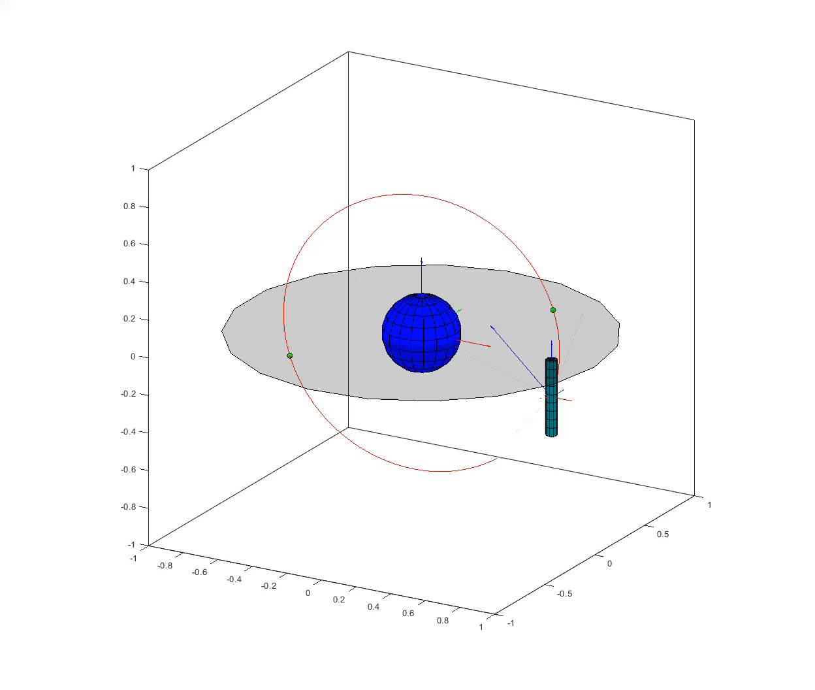
Attitude Controller – fine control
Max torque = 0.01 Nm, Max w_des = 0.2 rad/s
$ω_{desired}=K_{p}a_{error}+K_{i}∫a_{error}dt+K_{d}\frac{da_{error}}{dt}$
Step 3: Since we may have some initial angular velocity, we want our angular velocity increment provided by torques, $Δω=w_{desired}−w_{act},$ to be converted to torques using the angular velocity dynamics equation:
$$τ=I_{b}\left(\frac{Δw}{Δt}\right)−ω_{x}I_{b}ω=\frac{I_{b}\left(ω_{desired}−ω_{act}\right)}{Δt}−ω_{x}I_{b}ω$$

Slide 15
Attitude Controller – fine control
Max torque = 0.01 Nm, Max w_des = 0.2 rad/s
RW within torque and saturation specs
- Integral wind-up when crosses the zero boundary.
$ω_{desired}=K_{p}a_{error}+K_{i}∫a_{error}dt+K_{d}\frac{da_{error}}{dt}$
Step 3: Since we may have some initial angular velocity, we want our angular velocity increment provided by torques, $Δω=w_{desired}−w_{act},$ to be converted to torques using the angular velocity dynamics equation:
$$τ=I_{b}\left(\frac{Δw}{Δt}\right)−ω_{x}I_{b}ω=\frac{I_{b}\left(ω_{desired}−ω_{act}\right)}{Δt}−ω_{x}I_{b}ω$$

Slide 16
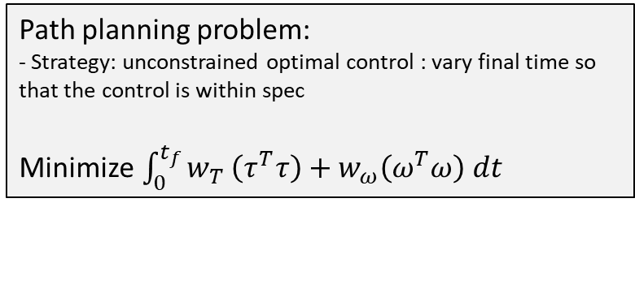
Takeaways
Alternate between ode45 to simulate the physics and a discretized model of the controller based on Kalman filtered estimates for a more realistic sim environment
Since last Friday… I have
Developed a visualization framework for satellite motion
Simulated a realistic orbital path by extracting information from TLE
Developed a Kalman Filter that successfully estimated the gyro bias and attitude for a realistic sensor suite
Developed a hierarchical strategy for attitude control while adhering to actuator constraints
Created a plan of action for further development
Develop a robust waypoint control strategy (angular rate and attitude) and analyze for robustness
Path planning problem:
- Strategy: unconstrained optimal control : vary final time so that the control is within spec
Minimize$\int_{0}^{t_{f}}{w_{T}}\left(τ^{T}τ\right)+w_{ω}\left(ω^{T}ω\right) dt$
Generate waypoints and develop controller to adhere to path

Slide 17
Orbital Disturbances

Slide 18
Pt 3: Use realistic actuator physics

Slide 19
Actuator Models

Slide 20
Actuator Locations

Slide 21
Control system analysis

Slide 22
Control system analysis

Slide 23
Pt 4: Detumbling

Slide 24
Pt 5: Reentry

Slide 25
Pt 6: Landing

Slide 26
Pt 7: Launch for specific orbit

